Slide 1
IOTA Membership and Subscription Numbers
Print
34 USA vs 43 in 2013 Oct
4 Outside USA vs 5 in 2013 Oct
Online-only
57 subscribers vs 46 in 2013 Oct
Net increase of 1 member

Slide 2
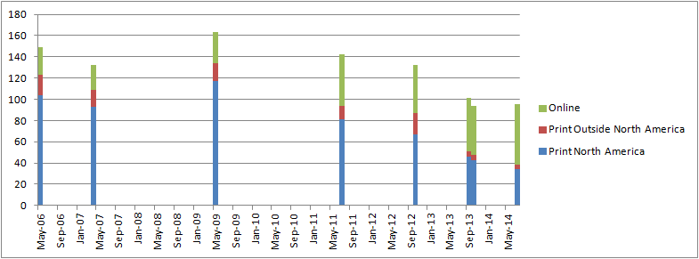
IOTA Membership Trends
Date | Print North America | Print Outside North America | Online | Total
14-July | 34 | 4 | 57 | 95
13-Oct | 43 | 5 | 46 | 94
Sep-13 | 46 | 5 | 50 | 101
Oct-12 | 67 | 20 | 45 | 132
Jul-11 | 81 | 13 | 48 | 142
May-09 | 117 | 17 | 29 | 163
Apr-07 | 93 | 16 | 23 | 132
May-06 | 104 | 19 | 26 | 149

Slide 3
IOTA Financial Overview
Starting Balance: 2013 October 3
$6,038.02
Ending Balance: 2014 July 2
$7,544.48
Net increase in Balance:
$1506.46 but…

Slide 4
IOTA Financial Details
Membership Income: $600
Interest: $?
IOTA-VTI Royalties: $528
PayPal Balance: $2128.19 but…
‘14 Web Services Fund $540
Expenses
Printing/mailing costs: $1372.75
JOA layout/design: $541.82 (2 issues!?)
Web service: Still donated
Awards Not paid for 2 years+!?
Fees: PayPal fees totaled $55.28

Slide 5
IOTA Business Items
JOA publication
Seemingly getting more and more behind per issue
Online access
New password protocol seems to be working fine
Remembering passwords is the only problem.
Complaints
None this past year…

Slide 6
Representative JOA 1402 costs
Layout/Design:
Of the order of $275 (Є195)
45 Copies Printed:
$202.83
Envelopes/Labels/Printable Postage Sheets:
$42.38 (purchased every few issues)
Postage:
$108.58

Slide 7
Representative JOA 1402 costs
Net cost of ~$628.79 for this issue
(“about” due to irregularity in supplies)
40 issues mailed so each issue cost ~$15.72
Price paid per issue by members depends upon several factors (location, payment & delivery options) but is ~$10.25

